Slide 1
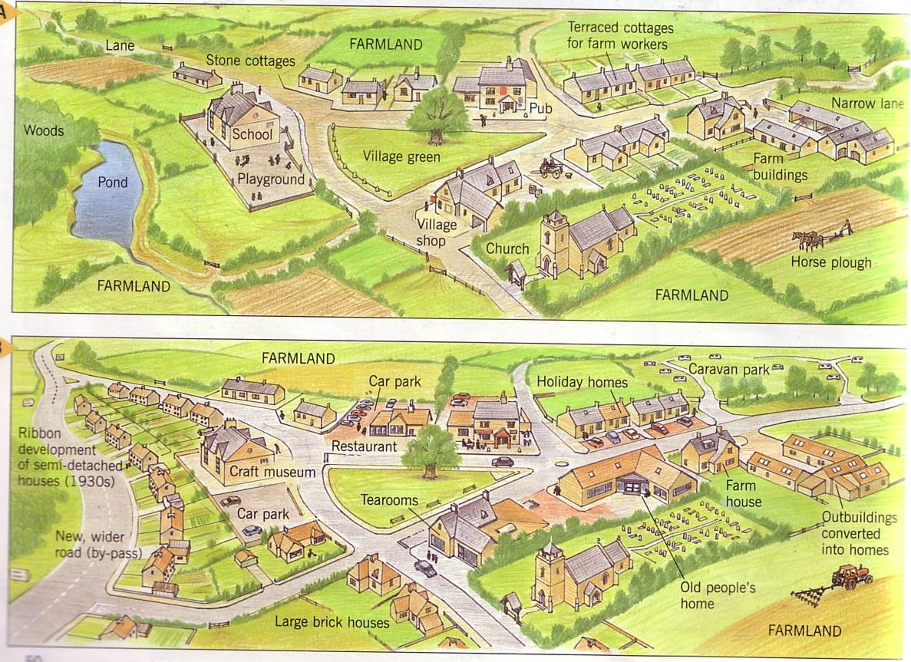
WALT: Understand why Settlements change with time
STARTER:
SPOT THE DIFFERENCE

Slide 2
WALT: Understand why Settlements change with time.
WILFS:
L4 – Describe the changes that take place.
L5 – Explain why these changes occur.
L6 – Compare different Settlements.

Slide 3
Discuss why you think these villages would have changed over the last 100 years?
How many reasons can you come up with…
Think of the following:
Jobs
Technology
People
Shopping

Slide 4
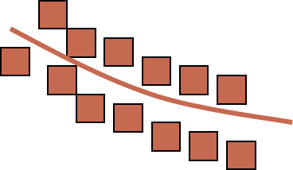
No town or village remains the same for ever. Over a period of time the following may change:
The shape of a settlement
The function of a settlement
The land use of a settlement
The number and type of people living in the settlement

Slide 5
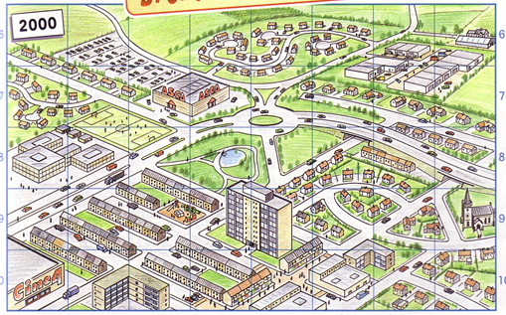
SPOT THE DIFFERENCE

Slide 6
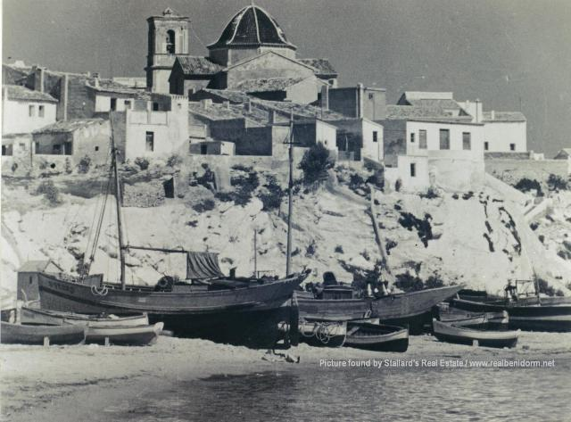
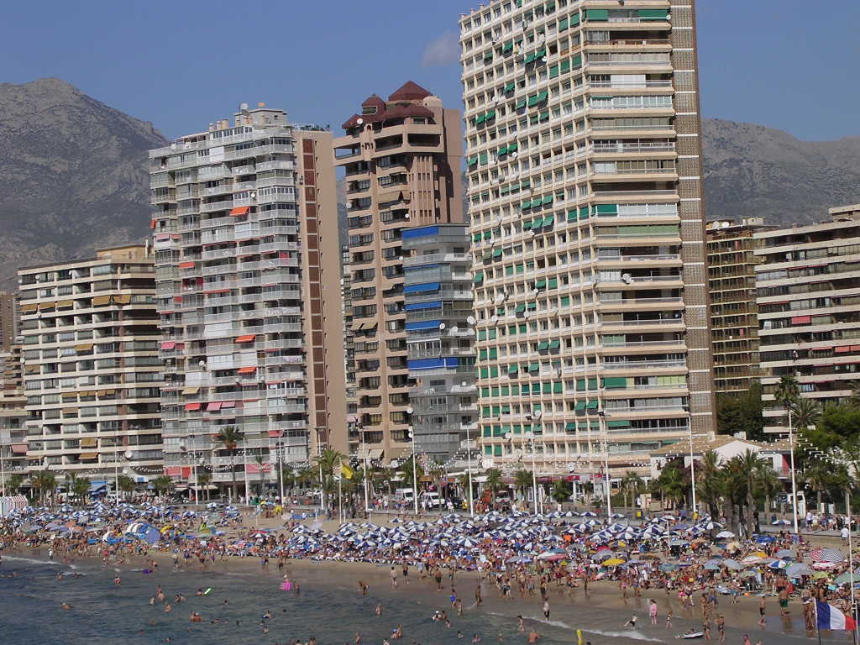
Benidorm – Settlement function.
1930’s
1980’s

Slide 7
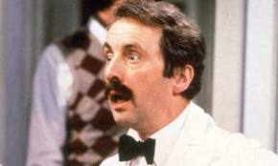
Role Play
In groups of FOUR
Describe who you are.
Describe what changes you have seen to your town.
Describe how this would make you feel.
Explain why these changes occurred.
EXAMPLE: “Hello, I am Manuel, I am from the beautiful city of Benidorm, in the 1930’s my village was beautiful but I had no work, by the 1950’s this changed with all the tourists, I had plenty of work and there were lots of new Hotels to employ me BUT my beautiful village had become a large…

Slide 8
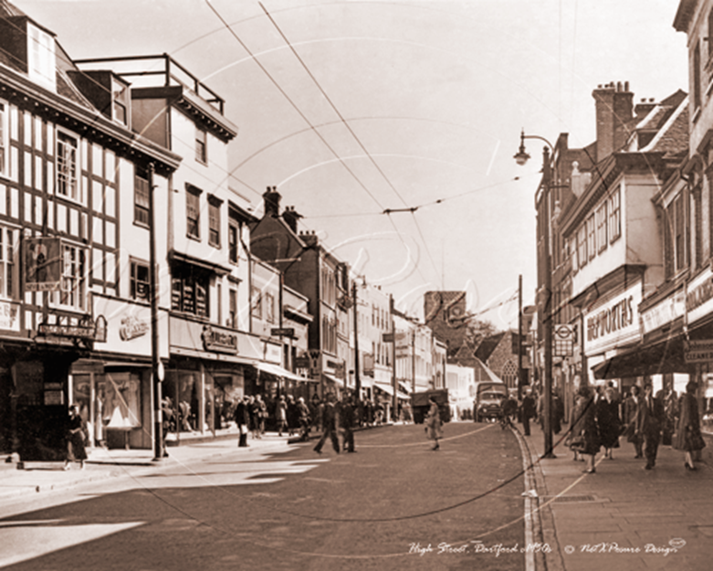
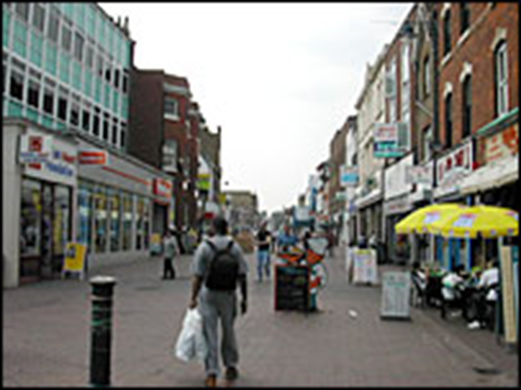
Dartford – Settlement Change.
http://news.bbc.co.uk/local/kent/hi/people_and_places/history/newsid_9137000/9137047.stm

Slide 9
Benidorm
Pretend you are someone born in Benidorm (Spain). You have seen many changes to your little village.
In the 1930’s it was a small fishing village with just a few hundred living there. It had beautiful beaches and very few tourists.
By the 1970’s it had been turned into a huge tourist town. Thousands of people visited each year, huge hotels had to be built.
By the 1990’s the tourists had stopped turning up.
You need to have someone pretending to be;
A villager (What was Benidorm in the 1930’s, how would you feel in 1970?)
A Hotel owner (Are the changes a good thing for you?)
A tourist (Why might you have stopped going (Hint: You could go elsewhere)
A builder (Why would you be happy in 1970 but not as happy in 1990)

Slide 10
Greenwich
Pretend you are someone born in Greenwich, London. You have seen many changes to your part of London.
In 1900 industrial areas had arrived: shipyards to build ships, and factories to make chemicals had been built. A huge gas works had opened.
By 1985 the industries and factories had closed down. Much of the area became unused and very few people lived there.
In 2000 it is very different, the millennium dome has been built and it has been turned into an area of entertainment that services the rest of London.
You need to have someone pretending to be;
A worker (What jobs (if you had one) would you be doing in 1900, 1985, 2000?)
A visitor (What would you have seen if you had visited Greenwich, what could you do?)
A tourist (Would you have visited in 1900, 1985 or 2000)
A builder (When would you be happiest?)

Slide 11
Welsh Village
Pretend you are someone born in a small village in Wales. You have seen many changes to your little village.
In the 1930’s it was a small village with just a few hundred living there. It had beautiful scenery but there wasn’t a lot else to do. It also had lots of coal waiting to be mined…
By the 1950’s it had been turned into a large mining town. People in much larger towns needed coal. Mines were built and people came to the village for work. The village grew to support this, more houses were built, more shops were needed to keep them happy.
By the 1990’s the coal wasn’t needed by the larger towns and the mines were closed. Suddenly people had to find other jobs.
You need to have someone pretending to be;
A villager (What was in the Village in the 1930’s, how would you feel in 1950?)
Worker (Are the changes a good thing for you? Would you have had a job in 1930?)
A Teenager. (There was no school in 1930, you had to travel, but there may have been one in 1950)
A builder (Why would you be happy in 1950 but not as happy in 1990)

