Slide 1
Linear Settlement

Slide 2
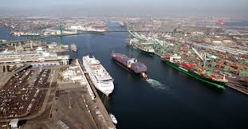
Port Settlement.

Slide 3
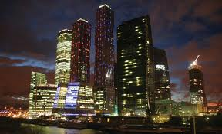
Capital Cities

Slide 4
Nucleated Settlement

Slide 5
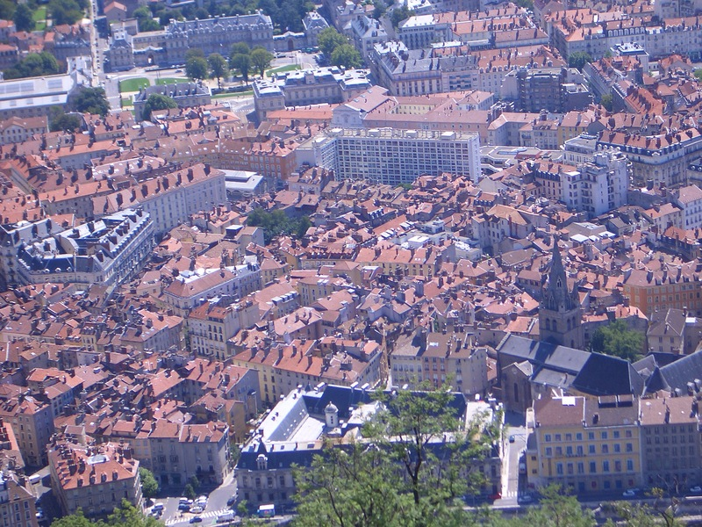
Large Town

Slide 6
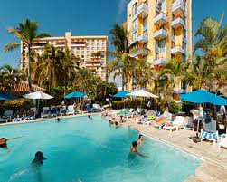
Resort Settlement

Slide 7
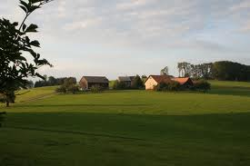
Hamlet

Slide 8
WALT: What have we learnt about settlements?
Level 3 – List the features of a good settlement location
Level 4 – Describe the features of a settlement
Level 5 – Explain your choice.

Slide 9
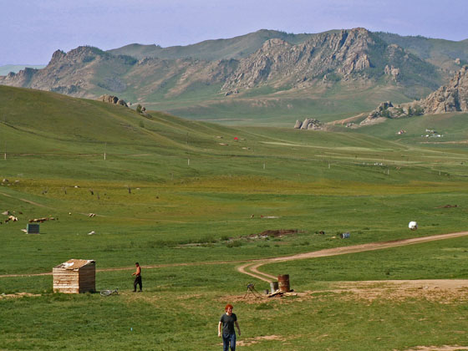
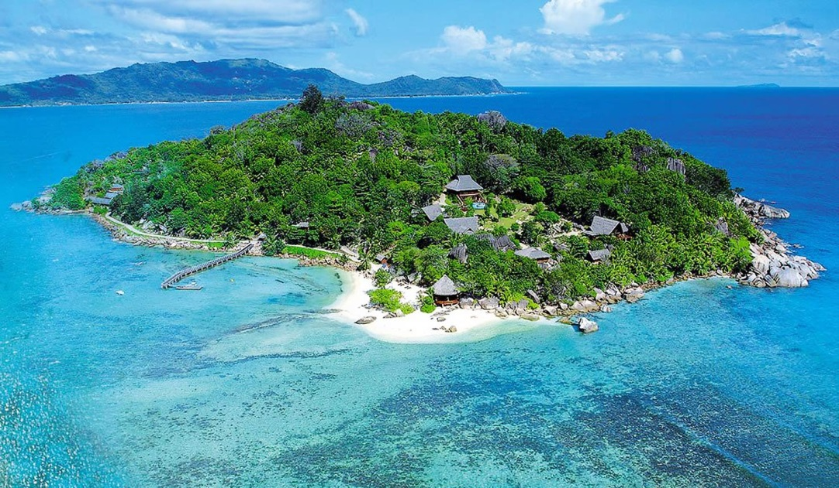
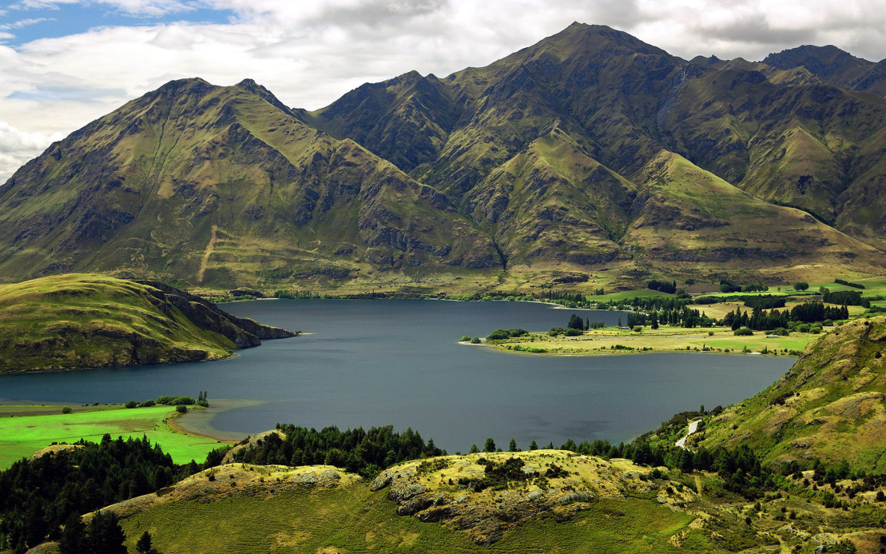
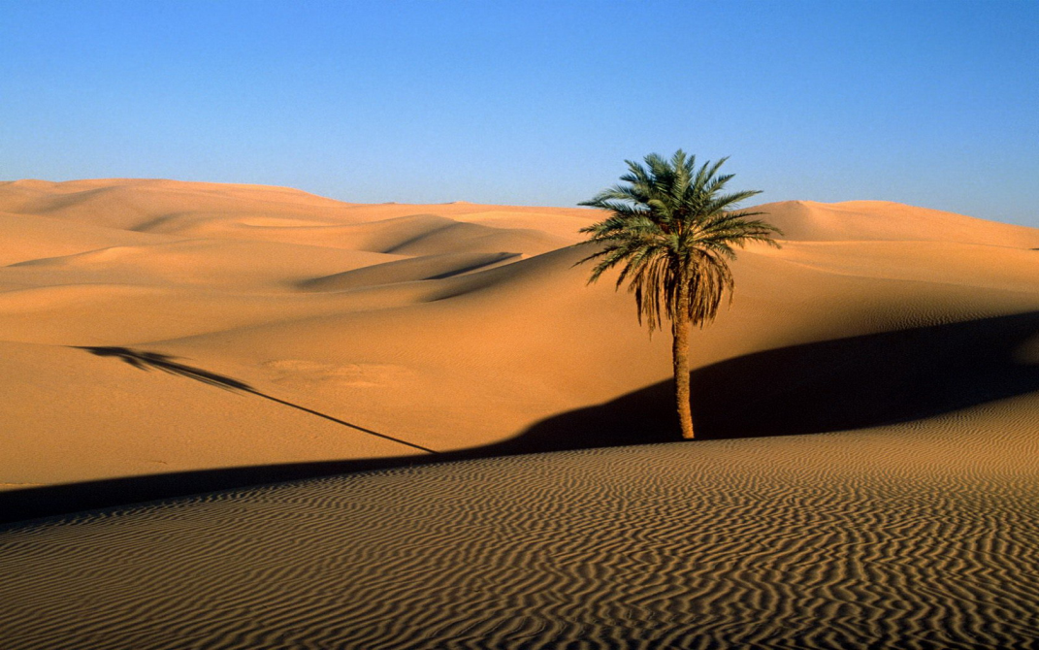
A
B
D
C

Slide 11
OS MAP BINGO
Church with a Tower
Church with a Spire
Caravan Site
Lighthouse
Golf Course
Wooded Area
Parking
Information Centre
Windmill
Historical Site
Picnic Area
Airport
Bus Stop
Hospital
First Aid
Marina
Sailing
Restrooms
Recycling
Post Office
Public House
Golf Course
Railway Station
Motorway
Footpath
Footbridge
Quarry

