Slide 1
WALT: Identify the function of a Settlement…
What can you remember from last week about Hierarchy. What goes at the bottom, what goes on the top. Write as much as you can remember on the White Boards.

Slide 2
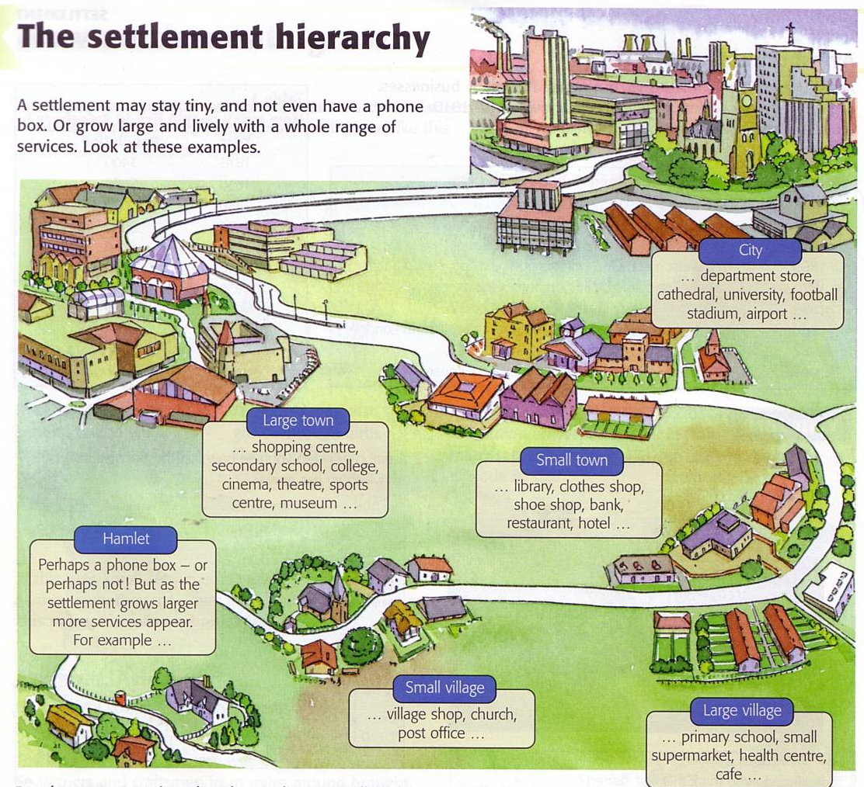

Slide 3
WALT: Identify the functions of Settlements.
WILFS
3 - A List of the functions of a Settlement
4 – A description of the functions of a Settlement
5 – Explain the function of a Settlement

Slide 4
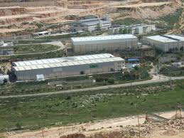
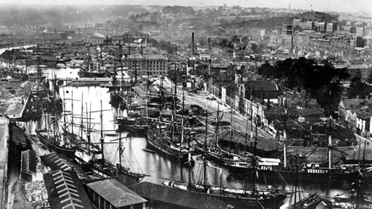
Industrial Settlement.

Slide 5
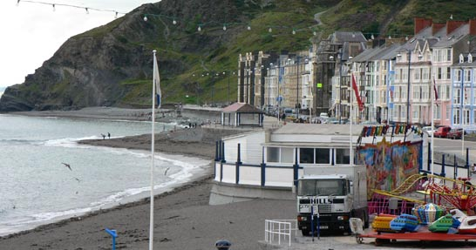
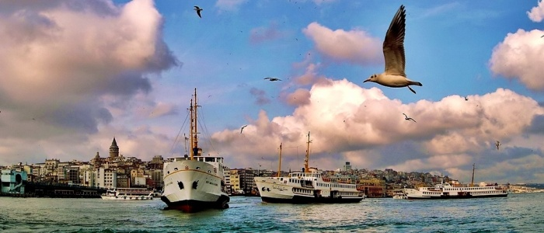
Port Settlement.

Slide 6
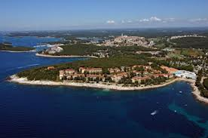
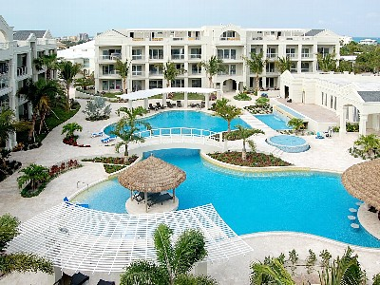
Resort Settlement.

Slide 7
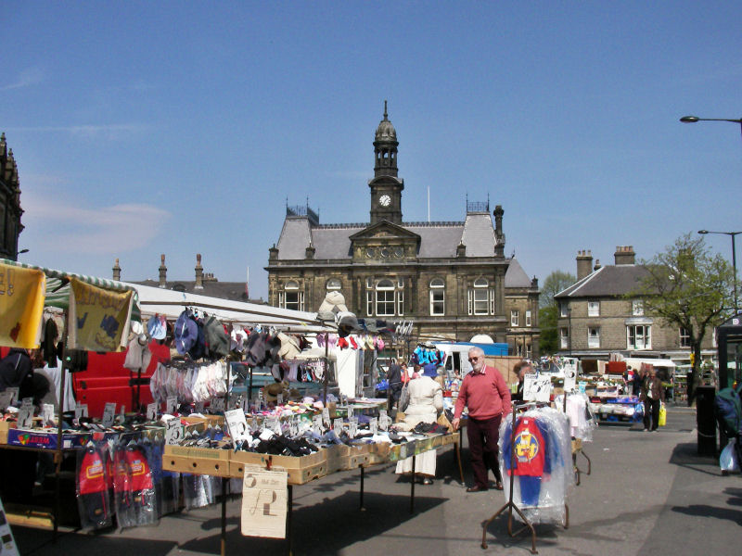
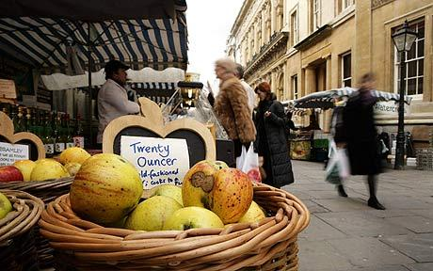
Market Settlement.

Slide 8
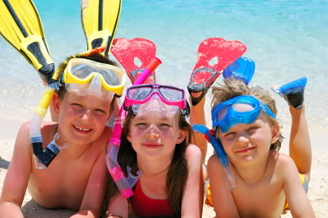
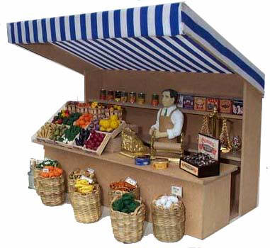
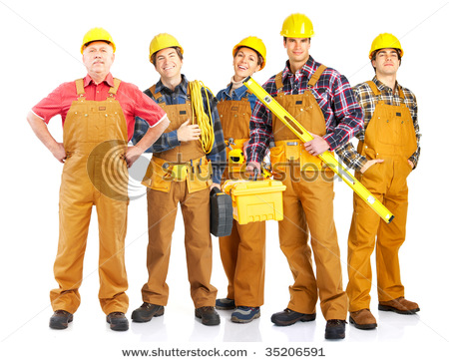
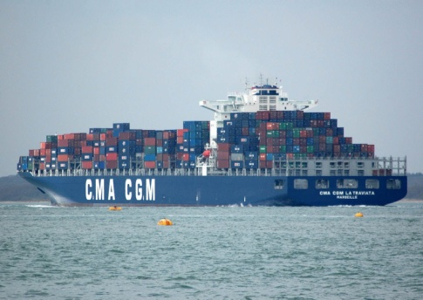
Settlement Functions
Choose the appropriate function from the following for each of the settlements being described to the left:
Holiday Resort; Market; Industrial; Port
2. A settlement indicator is a person or object that shows us the function of a settlement. Complete the table for what you think are most likely to find the following indicators (the answer might be for all of them)
I live in a __________. This is where people come from other places to relax and enjoy themselves
I live in a __________ town. My husband runs a farm. This is where we come to buy and sell things
 | Industrial | Port | Resort | Market
FACTORY
FUNFAIR
HOUSES
MARKET
SHOPS
DOCKS
COAL MINE
I live in a __________ town. I use things produced by farmers to make things
I live in a __________ town. This is where people and goods leave our country and arrive from other places

Slide 9
You say, We Pay.
Describe without using the actual words the picture to the person in the hot seat…

Slide 10
Linear Settlement

Slide 11
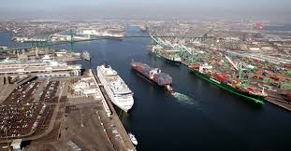
Port Settlement.

Slide 12
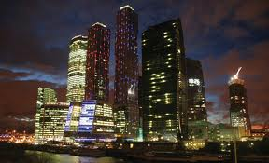
Capital Cities

Slide 13
Nucleated Settlement

Slide 14
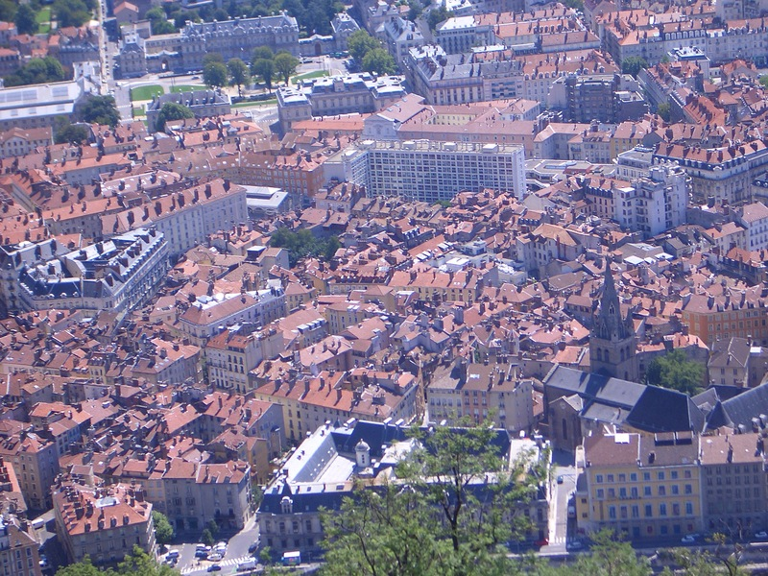
Large Town

Slide 15
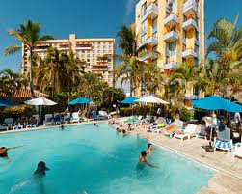
Resort Settlement

Slide 16
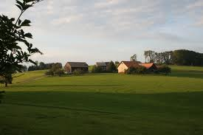
Hamlet

