Slide 1
WALT: Identify Florey & Chain’s contribution to the History of Medicine.
WILFS:
E - Description of what Florey and Chain achieved.
C - Explanation of Florey and Chain contribution to Penicillin
A - Evaluation of Florey and Chains contribution...

Slide 2
Alexander Fleming
Fleming was a farmer's son from Ayrshire in Scotland.
He moved to London at 13 and later trained as a doctor.
In 1928 Fleming was research assistant to Sir Almroth Wright working on bacteria.
He accidentally discovered a mould on a set of culture dishes, which were being used to grow the staphylococci germ (which turns wounds septic).
Fleming noticed that where there was mould the germs had stopped developing.
It was one of Fleming's colleagues who identified the mould as penicillin.
Fleming subsequently tested the penicillin on animals, with no ill effects, and also used it to cure a colleague's eye infection.

Slide 3
Florey & Chain
Alexander Fleming discovered penicillin in 1928 but did not fully realise the drug's potential.
No further research was carried out due to lack of funds and specialist help.
Howard Florey and Ernst Chain decided to develop Fleming's discovery further and set about finding a way to turn the penicillin mould juice into a pure drug, which would be more suitable for the treatment of humans.

Slide 4
Florey & Chain
Florey was born in 1898 in Adelaide, Australia.
He trained as a doctor and worked on a series of important discoveries at Oxford University.
Chain a brilliant Jewish biochemist joined Florey's research team after he fled to Britain from Nazi Germany.
Their development of penicillin in the early 1940s led to the award of the Nobel Prize alongside Fleming in 1945.

Slide 5
Florey & Chain
Chain was researching penicillin in 1929 when he read Fleming's article.
It was this research which encouraged Florey and Chain to set up a fuller investigation into the drug.
In 1940, Florey's team found a way of purifying penicillin which was tested first on mice and then on a patient, a policeman called Albert Alexander.
The patient began to recover after receiving the drug, but unfortunately supplies ran out due to their inability to produce it in large quantities.
Mass production of the drug was not possible without the help of large drugs companies.

Slide 6
What changes were brought about?
Florey managed to persuade US drug companies to mass produce penicillin when the US entered the war in December 1941 because it could be used to treat infections caused by war wounds.
The US government gave grants to drug companies who wanted to buy the expensive equipment needed to make penicillin.
Mass production began in 1943 by British firms.
By 1944 there was enough penicillin being produced to supply all the Allied armies.
The price of penicillin fell and soon it was being used throughout the world to treat a range of different diseases.

Slide 7
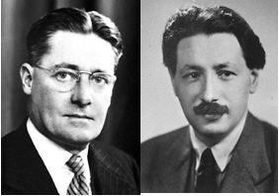
Florey and Chain
Howard Florey (left) and Ernst Chain.
It was the Second World War which
finally brought about the successful
development of penicillin.
In the 1930s two Oxford scientists, Howard Florey and Ernst Chain, became interested in Fleming’s 1929 paper on penicillin.
In 1939 they assembled a team of pathologists, chemists and biochemists, and three days after the outbreak of war Florey asked the British government for money to fund the team’s research into penicillin.
Notes:
What factors does this slide highlight? Individuals, governments

Slide 8
The development of penicillin
Stage 1:Growing the penicillin
This was a combination of the latest freeze-drying technology and some much more traditional equipment: thousands of milk bottles (in which to grow the bacteria), milk churns, a dog bath and a hand pump! From this, the team were able to gather a few grams of pure penicillin.
Stage 2: Testing penicillin on animals
There was enough penicillin to test it on eight mice. They were injected with a deadly bacteria (streptococci). Four of the mice were then given penicillin. 24 hours later the mice which had not been injected with penicillin were dead. Those who had been injected were healthy.
Stage 3: The first human trial of penicillin
By 1941 the team had enough penicillin to test it on a human. The patient had terrible abscesses which had spread from his mouth to his scalp, eyes, arm and even his lung. He was going to die – there was nothing to lose by trying penicillin. After four days of treatment he was much improved and was sitting up in bed – penicillin worked. However, they did not have enough, and after five days the supply ran out – the patient relapsed and died.
Notes:
Factors: technology, scientific experiment, individuals

Slide 9
Production continues... but not in great quantities!
Although this first patient still died, it was clear that penicillin was a powerful drug. Production remained painfully slow, but as new batches were produced, two more patients were successfully treated.
In August 1942, Fleming himself used penicillin to successfully treat a friend who had meningitis.
But the war was producing thousands of casualties – penicillin needed to be mass produced if lives were to be saved.

Slide 10
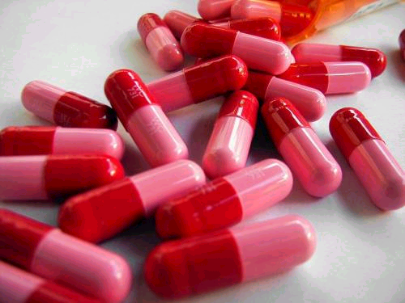
Steps to Successful Mass Production
June 1941: Florey travels to US to try to get drug companies to develop penicillin – not much interest.
December 1941:
US enters the war
1942:
US government gives $80 million to 4 drug companies to find a way to mass produce penicillin.
1943: Mass production began. Penicillin first used by British army in North Africa.
June 1944: Enough penicillin is available to treat all the casualties of D-Day.
1945: US Army using 2 million doses of penicillin a month
After WW2: Penicillin made available for civilian use.
Notes:
Communication, war, governments, industry

Slide 11
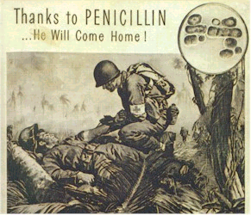
How important was penicillin?
It is estimated that without penicillin, another 12-15 per cent of wounded Allied soldiers would have died of infections.
Penicillin also roughly halved the average time the Allied wounded spent in hospital.

Slide 12
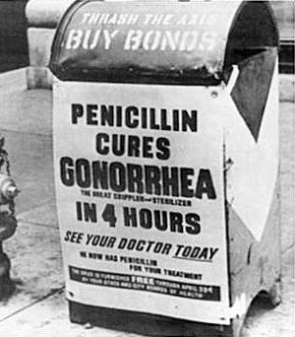
How important was penicillin?
Penicillin was a miracle drug when it was first developed. It could treat a wide range of infections and diseases, including streptococcus, scarlet fever, syphilis and gonorrhoea.
In 1945, Fleming, Florey and Chain were jointly awarded the Nobel Prize for Medicine for their work on penicillin.
Notes:
How would we rate the significance of these men against Pasteur, Koch, Lister, Ehrlich...

