Slide 1
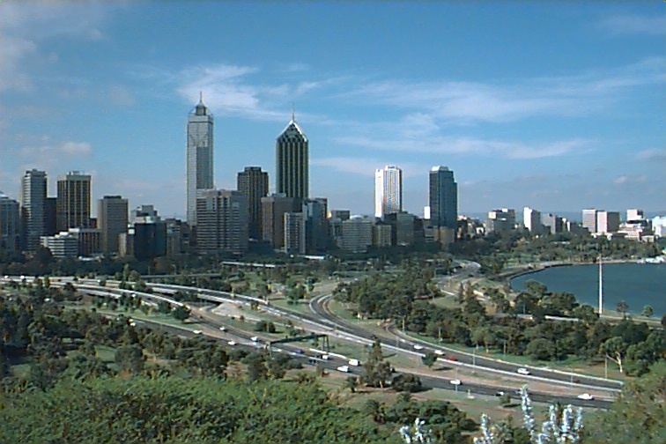

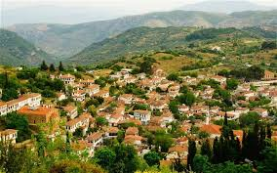
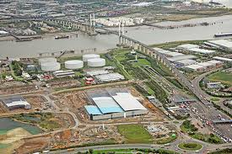
Write down which is the odd one out and WHY ?
Think of many reasons as possible.

Slide 2
WALT: How do settlements change over time?
L3 – List the ways settlement change.
L4 – Describe the changes…
L5 – Explain why these changes take place.

Slide 3
How the patterns grows.
Towns grow out from the Centre. So that’s where the oldest buildings are.
Also where the main shops and offices are.
Why might that be?

Slide 4

This is a Town… Have I gone mad…

Slide 5
The CBD.
Known as the Central Business District…
Large shops and offices.
Restaurants, Cafes, museums, cinemas and theatres.

Slide 6

19th C Housing.
Terraced houses for factory workers. Some now replaced by flats. Small corner shops.
This area is the transition zone or inner city.

Slide 7

Housing 1920-1950.
Larger Houses ususally with gardens. Some parks. Some rows of shops. This area is the inner suburbs

Slide 8

Modern Housing.
New houses and estates.
New shopping centres.
Parks and other open areas.
Known as outer suburbs.

Slide 9

Old Industrial.
Along a river, canal or railway.
Many old factories now closed.
Area may look run down.

Slide 10
New industrial area.
Industrial estates and business parks built since 1970.
Close to may roads

Slide 11
Page 33
Answer Questions
1a
1b
1c
1d
Extension – Can you explain the Pie Chart in your own words…

Slide 12
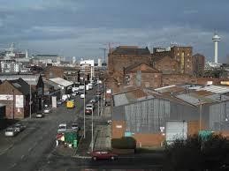

Slide 13
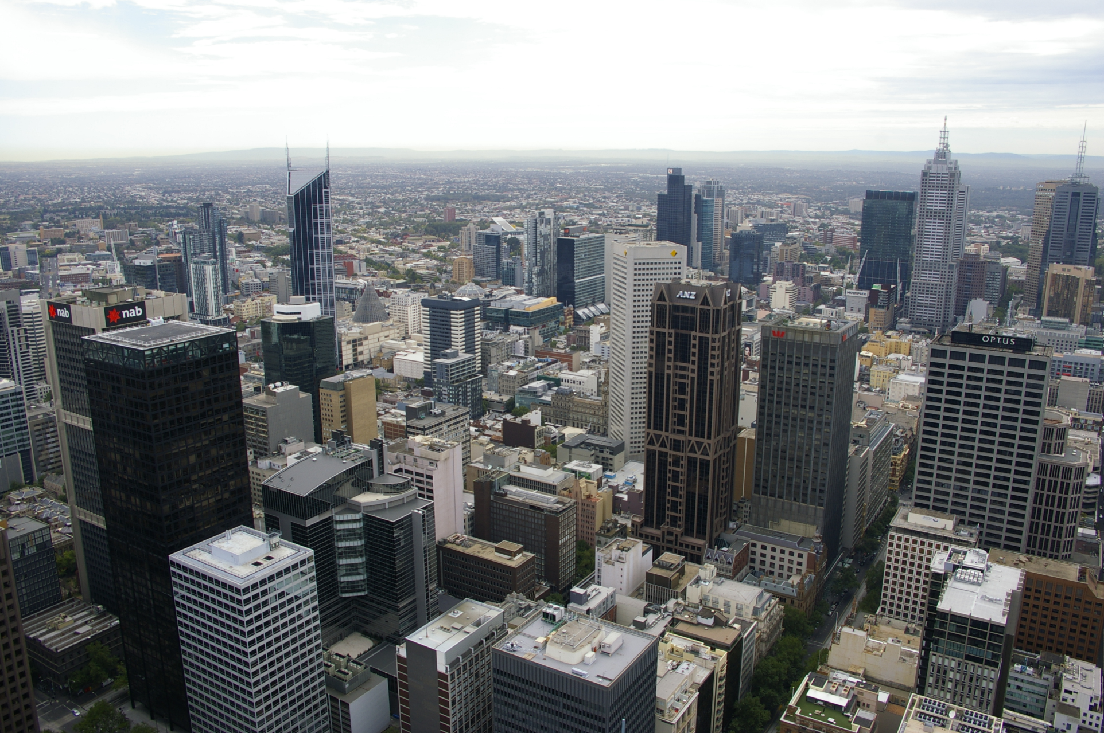

Slide 14
