Slide 1
Remember the different shapes?
Linear Settlement – Buildings are along a road or another feature
HANDS UP IN LINE
Nucleated Settlement – Buildings are grouped together around a focus point. IE Bridge or Crossroads.
MAKE A CIRCLE
Dispersed Settlement - where few buildings are spread over a large area
HANDS WIDE APART
WALT: What is Settlement Hierarchy?

Slide 11
WALT: What is Settlement Hierarchy?
L3-List the Settlement Hierarchy
L4 – Describe the Settlement Hierarchy
L5- Explain the differences.

Slide 12
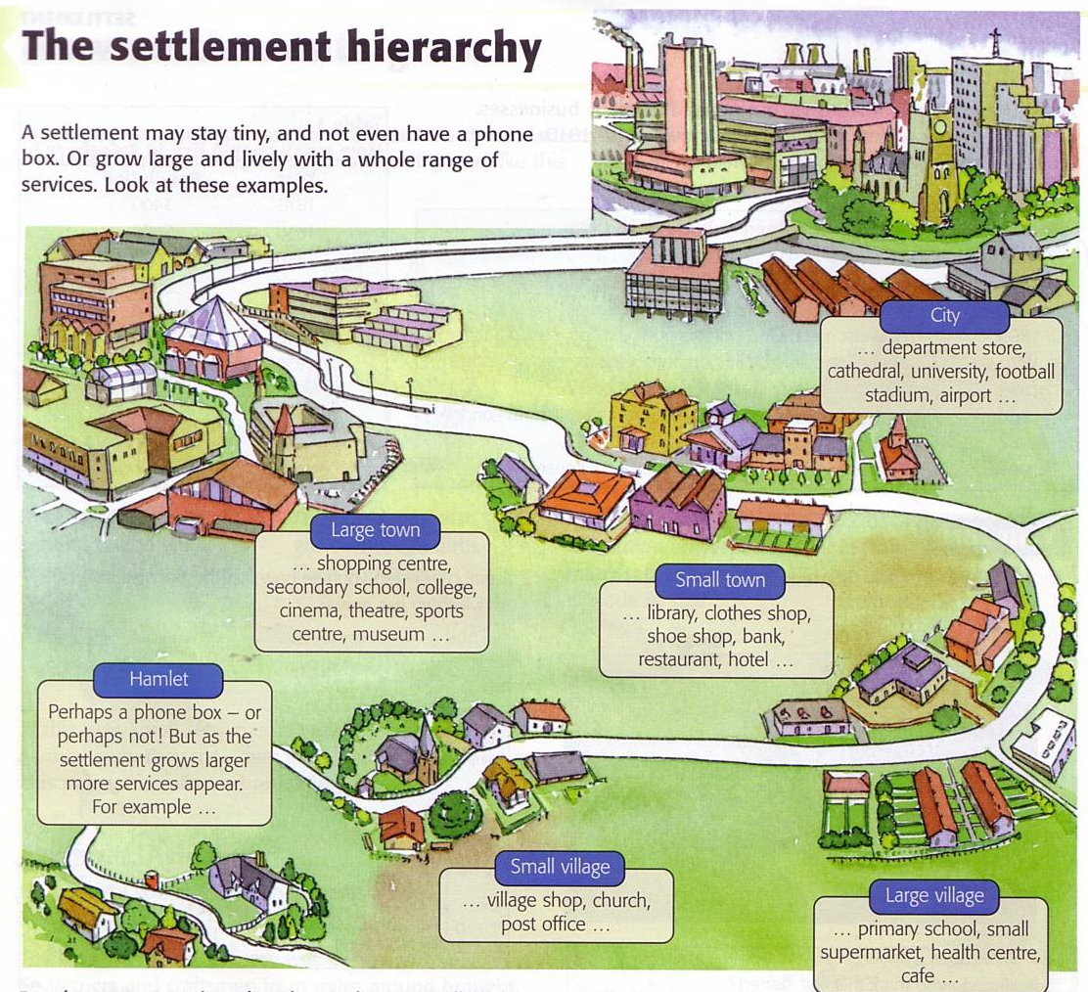

Slide 13
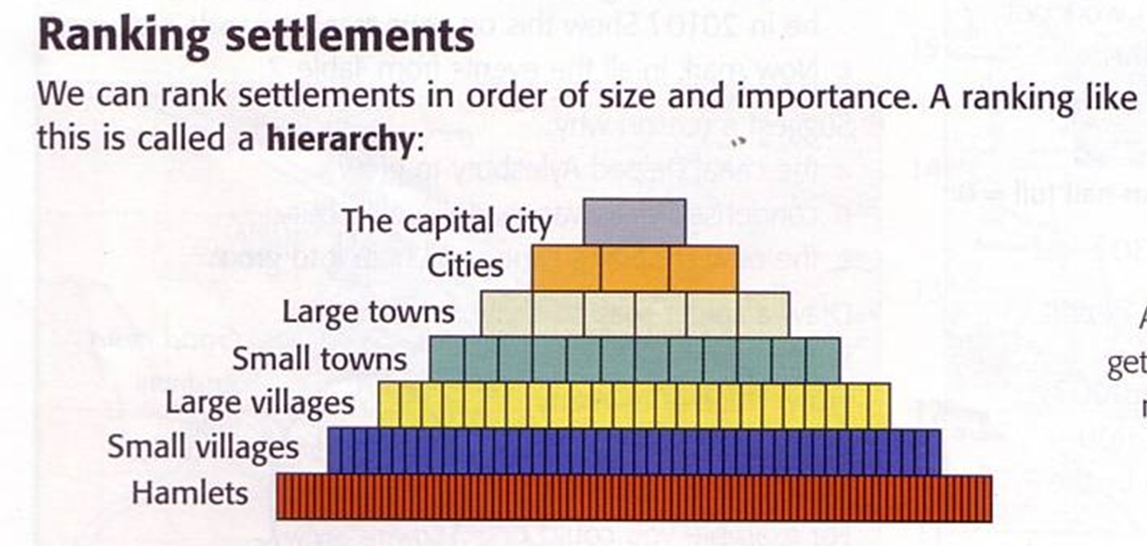

Slide 14
Task -
Complete the Worksheet
Use the information around the room to help you if you need it
Ext : Answer the following Question
“ What are the differences between a Hamlet and a Capital City?

Slide 15
Hamlet
The smallest Settlement
Perhaps a phone box… Not a lot more
They are a small cluster of houses. It doesn’t have any services such as a church, a school.

Slide 16
village
Village shop, Church, Post Office = Small
Village Hall, Small supermarket, Health Centre & a café = Large
A place that is usually large enough to have a church, a primary school, and a shop.

Slide 17
town
Library, clothes shop, shoe shop, bank, restaurant, hotel = Small Town
Shopping Centre, Secondary School, College, Cinema, Theatre, Sports centre, Museum = Large Town
Is a settlement large enough to have at least one secondary school. It is likely to have bus and railway stations, leisure centre, a hospital and its own town hall.

Slide 18
cities
Department Store, Cathedral, University, Football Stadium, Airport
Is a very large settlement, with excellent road and rail links. It probably has a cathedral and a university, as well as many shops selling luxury goods such as jewellery and expensive clothes.

Slide 19
Capital city
Is a huge built-up area that has many millions of people. It is likely to have several universities, a regional shopping centre and an international airport.

Slide 21
homework
You’ve just visited the following places.
Hamlet, Village, Town, City and a Capital.
Describe what you saw in each of the places.
What were the differences?

